Slide 1
Languages and Compilers
(SProg og Oversættere)
Lexical analysis
Notes:
Navn
Studiekort
Edited

Slide 2
Lexical analysis
  Describe the role of the lexical analysis phase
  Describe lexemes and tokens
  Describe how a scanner can be implemented by hand
  Describe how a scanner can be auto-generated
  Describe regular expressions and finite automata and how they relate to implementations of scanners
Notes:
Kort

Slide 3
Syntax Analysis: Scanner
Dataflow chart
Source Program
Stream of Characters
Scanner
Error Reports
Stream of “Tokens”
Parser
Error Reports
Abstract Syntax Tree
Notes:
Første del I syntax analysis fasen

Slide 4
1) Scan: Divide Input into Tokens
An example ac source program:
f b
i a
a = 5
b = a + 3.2
p b
Lexems are “words” in the input, for example keywords, operators, identifiers, literals, etc.
Tokens is a datastructure for lexems and additional information
scanner
floatdl
id
intdcl
id
id
assign
inum
...
f
b
i
a
a
=
5
assign
id
plus
fnum
print
id
eot
...
=
a
+
3.2
p
b
Notes:
One token missing which?
B er missing

Slide 5
1) Scan: Divide Input into Tokens
An example ac source program:
f b
i a
a = 5
b = a + 3.2
p b
Lexems are “words” in the input, for example keywords, operators, identifiers, literals, etc.
Tokens is a datastructure for lexems and additional information
scanner
floatdl
id
intdcl
id
id
assign
inum
...
b
a
a
5
assign
id
plus
fnum
print
id
eot
...
a
3.2
b
Notes:
Unødvendig information

Slide 6
Implement Scanner based on RE by hand
Express the “lexical” grammar as RE
(sometimes it is easier to start with a BNF or an EBNF and do necessary transformations)
For each variant make a switch on the first character by peeking the input stream
For each repetition (..)* make a while loop with the condition to keep going as long as peeking the input still yields an expected character
Sometimes the “lexical” grammar is not reduced to one single RE but a small set of REs – in this case a switch or if-then-else case analysis is used to determine which rule is being recognized, before following the first two steps
Notes:
Regular expression til at lave regeler
Hver variant inde I en regel lav en switch for at finde ud af hvilken variant passer
Accept så længe man får et expected character
Nogle gange er det ikke nok bare at have en switch, men if kan også være nødvendigt hvis flere RE I grammar

Slide 7
Developing a Scanner
Express the “lexical” grammar in EBNF
Token ::= Identifier | Integer-Literal | Operator |
; | : | := | ~ | ( | ) | eot
Identifier ::= Letter (Letter | Digit)*
Integer-Literal ::= Digit Digit*
Operator ::= + | - | * | / | < | > | =
Separator ::= Comment | space | eol
Comment ::= ! Graphic* eol
Now perform substitution and left factorization...
Token ::= Letter (Letter | Digit)*
| Digit Digit*
| + | - | * | / | < | > | =
| ; | : (=|ε) | ~ | ( | ) | eot
Separator ::= ! Graphic* eol | space | eol
Notes:
Left Factoring is a grammar transformation technique. It consists in "factoring out" prefixes which are common to two or more productions.
Sætter dem sammen til en stor, der beskriver hvad en token kan være

Slide 8
Developing a Scanner
Token ::= Letter (Letter | Digit)*
| Digit Digit*
| + | - | * | / | < | > | =
| ; | : (=|ε) | ~ | ( | ) | eot
private byte scanToken() {
switch (currentChar) {
case ‘a’: case ‘b’: ... case ‘z’:
case ‘A’: case ‘B’: ... case ‘Z’:
scan Letter (Letter | Digit)*
return Token.IDENTIFIER;
case ‘0’: ... case ‘9’:
scan Digit Digit*
return Token.INTLITERAL ;
case ‘+’: case ‘-’: ... : case ‘=’:
takeIt();
return Token.OPERATOR;
...etc...
}
Notes:
Eksempel på hvordan en scanner kan se ud

Slide 9
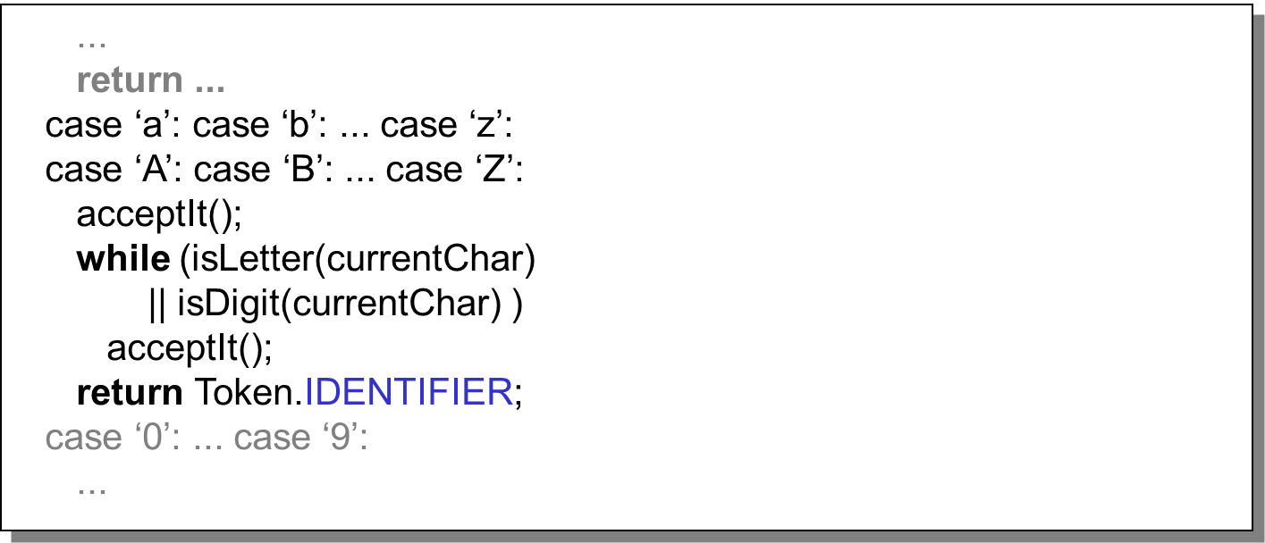
Developing a Scanner
Let’s look at the identifier case in more detail
Thus developing a scanner is a mechanical task.
Notes:
Hvis et bogstav så acceptere vi det og derefter bliver vi ved med at acceptere så længe de næste tegn er karaktere eller tal, hvorefter vi returnere det

Slide 10
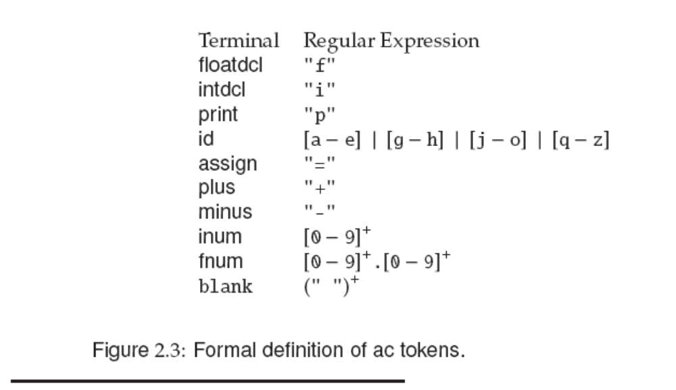
Token Specification
Notes:
Draw DFAs !
Eksempel på et sprog

Slide 11
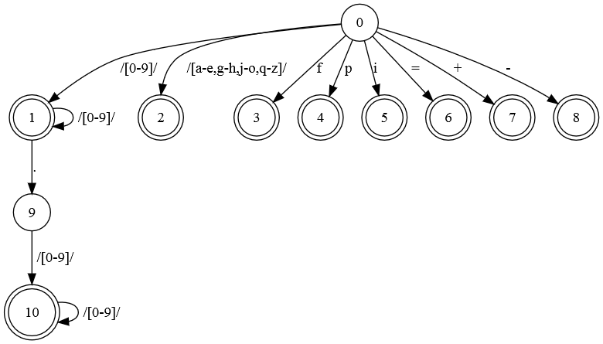
[0-9]+|[0-9]+.[0-9]+|[a-e,g-h,j-o,q-z]|f|p|i|=|\+|-
Notes:
DFA der beskriver hvordan scanneren skal acceptere karaktere

Slide 12
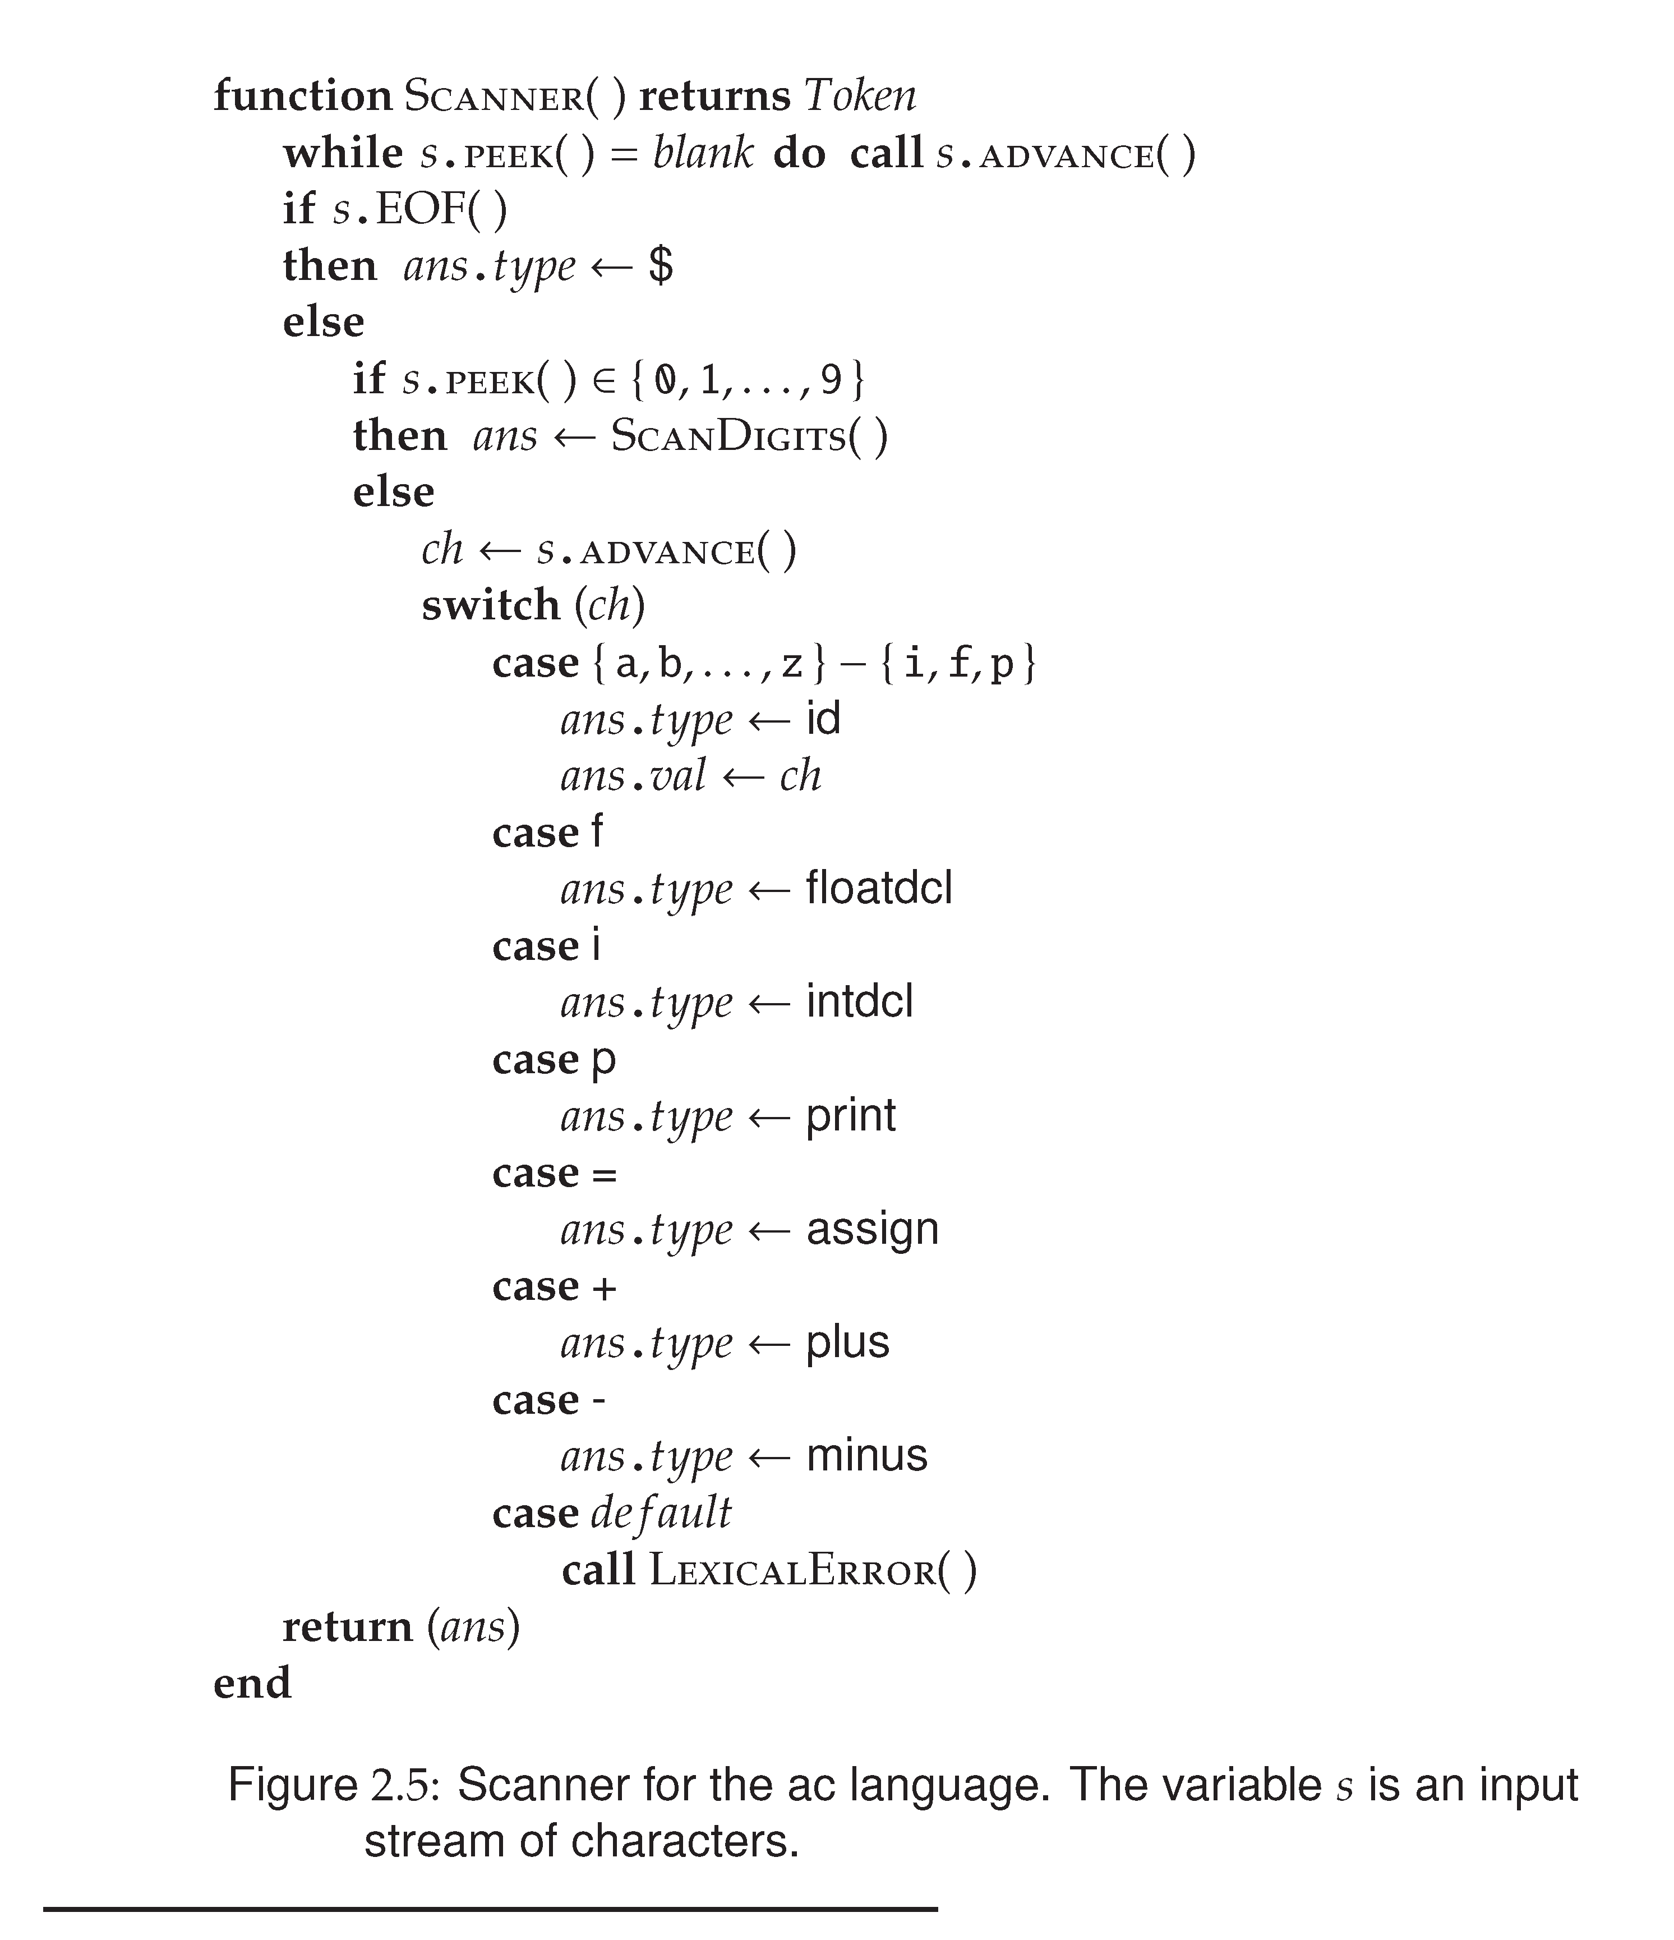
Notes:
Eksempel på en scanner for det sprog der blev vist
Tjekker først om end of file
Tjekker om det er et tal, hvis: kald scan digits som bliver besrkevet på næste side
Ellers tjek om det passer med nogle I switchen.

Slide 13
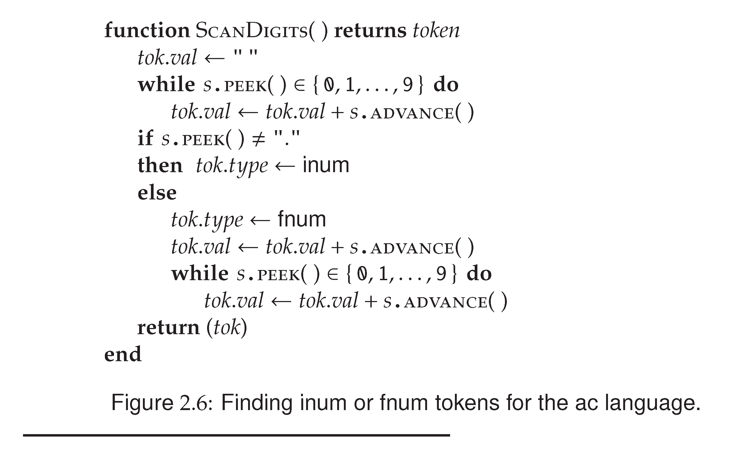
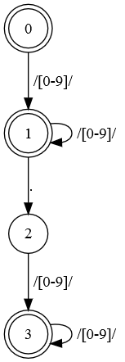
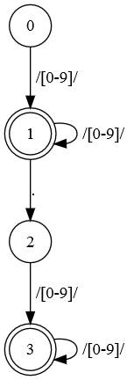
Notes:
Note: fejl is FA, der skal ikke være en tilstand efter . Da der teknisk set kan være tal uden decimaler e.g. 1.
Accepter tal og lav til int, men hvis . Så accepter ”.” og kommental og lav til float

Slide 14
Generating Scanners
Generation of scanners is based on
  Regular Expressions: to describe the tokens to be recognized
  Finite State Machines: an execution model to which RE’s are “compiled”
A possible algorithm:
- Convert RE into NDFA-ε
- Convert NDFA-ε into NDFA
- Convert NDFA into DFA
- generate Java/C/... code
Notes:
RE beskriver token, kan bruges I FSA til at lave disse tokens.
Ikke bare lige at lave en DFA, et par skridt på vejen, men ender med at kunne scanne sprog.
UNDERSØG

Slide 15
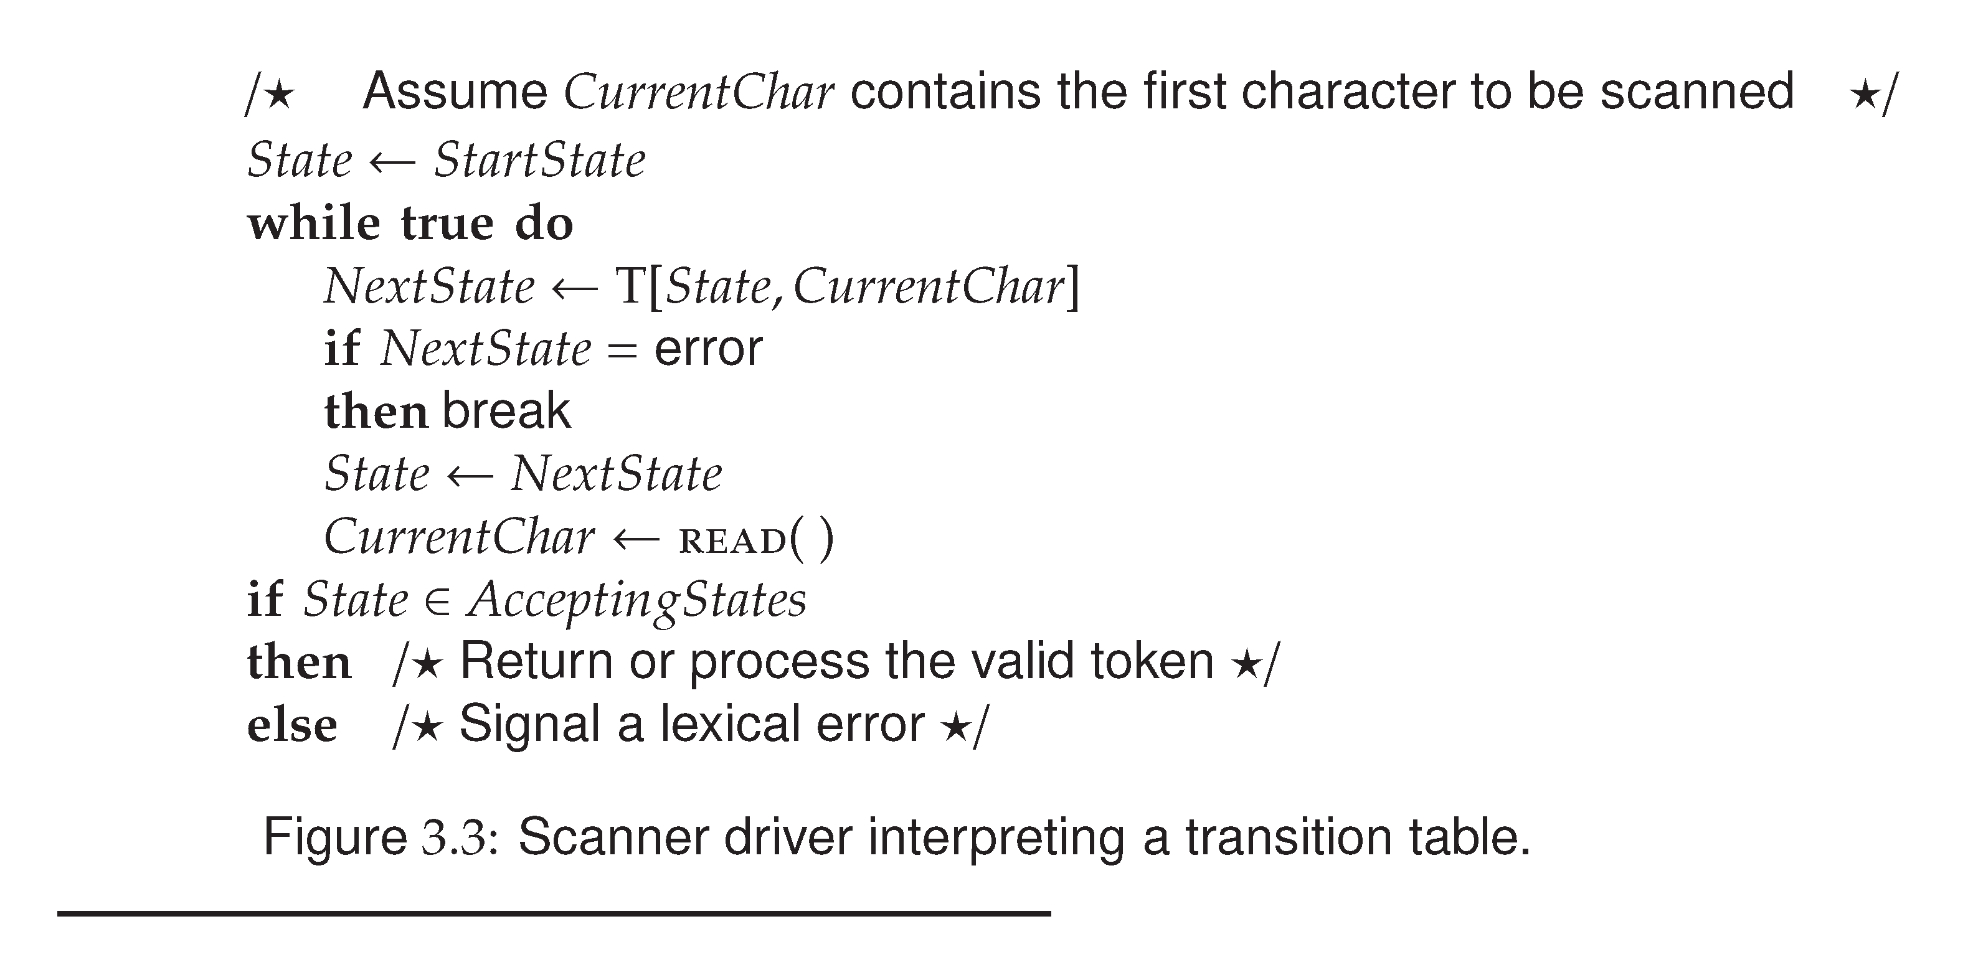
Implementing a DFA
Notes:
Laver start state
Slår op I tabellen hvad den næste state er
Fortsætter derefter hvis der ikke er fejl
Hvis den slutter I en accept state return token, hvis ikke det er accept så fejl.

Slide 16
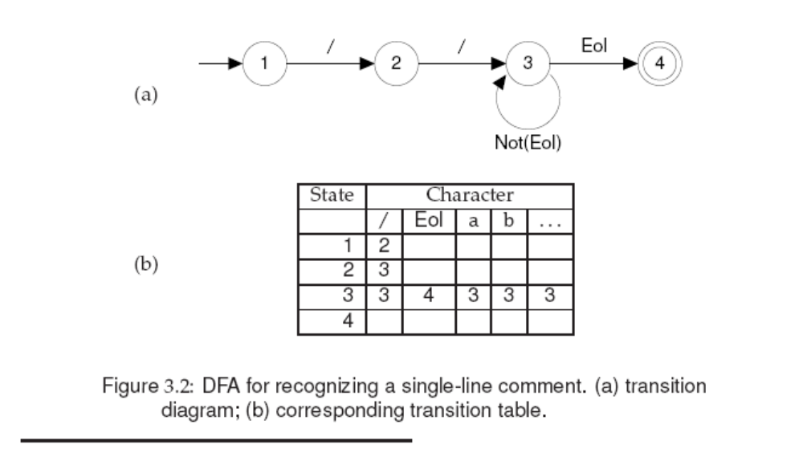
Comment -> //(Not(Eol))*Eol
Notes:
DFA der beskriver en ”//” token
Transition tabel over ”//” token
De to første skal være / og /, mens alt efter kan være alt undtagen End of line

Slide 17
Implementing a Scanner as a DFA
Slightly different from previously shown implementation (but similar in spirit):
  Not the goal to match entire input
  => when to stop matching?
      Token(if), Token(Ident i) vs. Token(Ident ifi)
    Match longest possible token
    Report error (and continue) when reaching error state.
  How to identify matched token class (not just true|false)
    Final state determines matched token class
Notes:
Man skal matche den længst mulige token, hvilket ville være “ifi”
UNDERSØG

Slide 18
Performance considerations
Performance of scanners is important for production compilers, for example:
  30,000 lines per minute (500 lines per second)
  10,000 characters per second (for an average line of 20 characters)
  For a processor that executes 10,000,000 instructions per second, 1,000 instructions per input character
  Considering other tasks in compilers, 250 instructions per character is more realistic
Size of scanner sometimes matters
  Including keyword in scanner increases table size
    E.g. Pascal has 35 keywords, including them increases states from 37 to 165
    Uncompressed this increases table entries from 4699 to 20955
Notes:
Kræver mange operationer, så derfor vigtigt at den kan gøre det godt.
Betyder også noget hvilket sprog man vil scanne, da tabeller bliver meget større hvis man har mange keywords.

